Slide 1
STUDENT MANAGEMENT SYSTEM
TEAM MEMBERS
1.Nalabati H S N S Vaishnavi-25A31A0585(team leader)
2.Nallajarla Venkata Naga Sai Lakshmi Kavya-25A31A0586
3.Nalla Kashyap Shrivatsa-25A31A05AT
4.Penneddy Veera Venkata Satyanarayana-25A31A05AU

Slide 2
INTRODUCTION
A Student Management System is used to store and manage student records such as ID, name, and marks.
Traditional methods become inefficient when handling large data.
Using a Linked List allows dynamic storage and easy modification of records.
This project implements CRUD operations using linked list for efficient data management.

Slide 3
CONCEPTS USED
Linked List Data Structure: Stores student records dynamically.
Node Structure: Each node contains student details and a pointer.
Dynamic Memory Allocation: Allocates memory at runtime.
Pointers: Used to connect nodes.
Traversal: Used to display and search records.
CRUD Operations: Create, Read, Update, Delete.

Slide 4
IMPORTANCE
Provides efficient student data management.
Allows dynamic memory usage.
Makes insertion and deletion easy.
Helps in understanding data structures.
Useful in real-world applications like school systems.

Slide 5
WORKING OF THE STUDENT MANAGEMENT SYSTEM
The program starts with an empty linked list.
Each student is stored as a node.
User selects operations from menu.
Add operation inserts new student.
Search finds student by ID.
Update modifies existing data.
Delete removes a student.
Display shows all records.
Program runs until exit.

Slide 6
CODE
// Create node
Student* newNode = new Student();
newNode->next = NULL;
// Insert
if (!head) head = newNode;
else {
Student* temp = head;
while (temp->next) temp = temp->next;
temp->next = newNode;
}
// Traverse
Student* temp = head;

Slide 7
while (temp) temp = temp->next;
// Search
while (temp && temp->id != key)
temp = temp->next;
// Update
temp->name = newName;
temp->marks = newMarks;
// Delete
prev->next = temp->next;
delete temp;

Slide 8
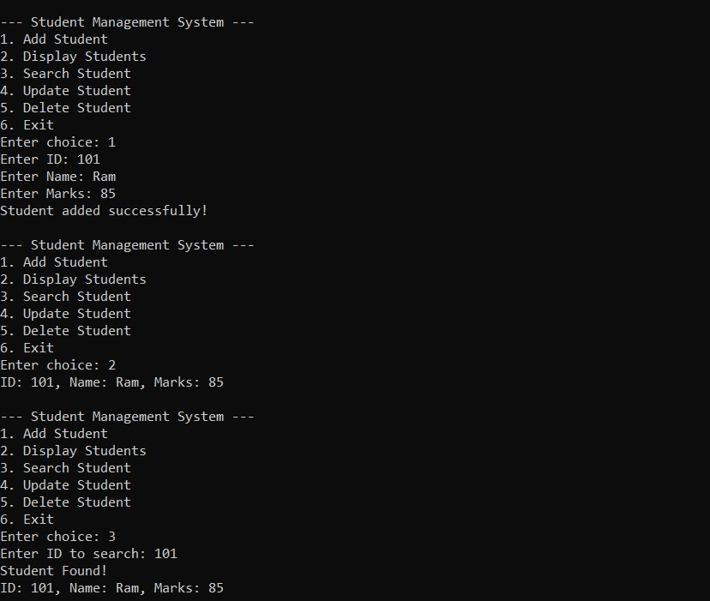
OUTPUT

Slide 9
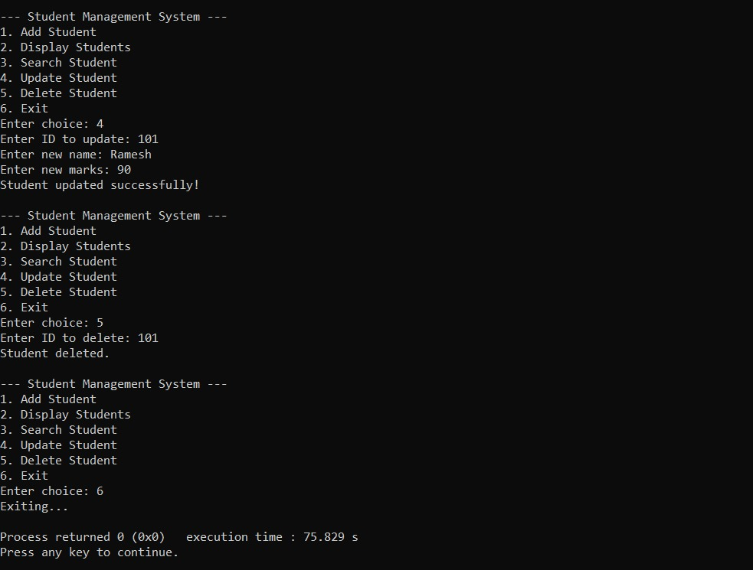

Slide 10
ADVANTAGES
Dynamic size of data.
Efficient insertion and deletion.
Better memory usage.
Easy to manage records.
Flexible structure.

Slide 11
CONCLUSION
The Student Management System using Linked List is efficient and easy to use.
It demonstrates CRUD operations clearly.
This project helps in understanding linked list concepts practically.

